Slide 1
Introduction to SQL and relational databases
CMPSC221

Slide 2
What is SQL?
SQL is a special-purpose programming language designed for managing data held in a relational database management system (RDBMS)

Slide 3
History of database systems
First started as flat files: ordinary unstructured files
To access, entire file must be read into memory
Hierarchial database model:
Data is structured in a tree like model using parent/child relationships
Relational database
Created by e. cobb, organization is based on the relationship of data
Document database
Manages semi-structured data in documents (NOSQL database for instance)

Slide 4
Relational databases
Consist of entities. Entities are related to each other using a variety of relationships
One to one relationship
One to many relationship
Many to Many relationship

Slide 5
What is an entity?
In the database world, an entity is something that may exist independently
Book
Car
User
author

Slide 6
Entities in relational databases
In relational databases, each entity is its own database table
A table contains related data
Consists of rows and tables

Slide 7
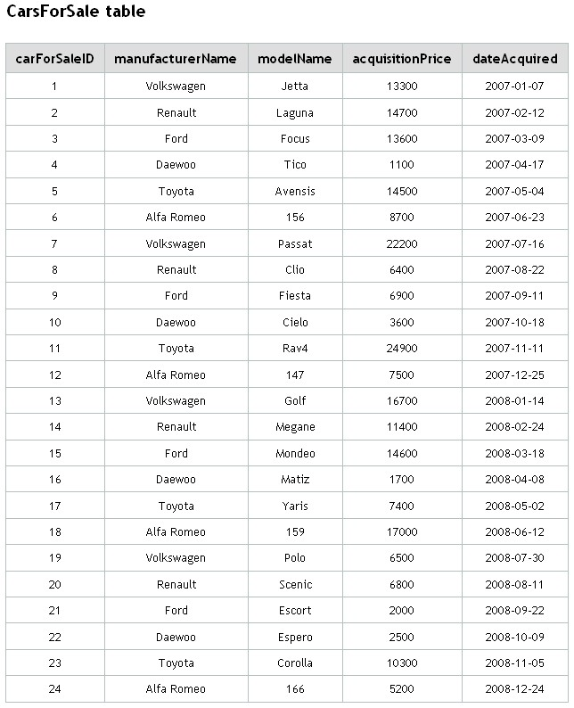
A table example

Slide 8
Fields in a database
Each field in a table in a relational database is given a data type
Examples:
NUMERIC
CHARACTER
DATE and TIME
INTEGER
Et al.

Slide 9
As an example - car
VIN -> integer
Manufacturer name -> varchar(50)
Model -> varchar(50)
Manufactured date -> datetime
Msrp -> double

Slide 10
Creating a car table in a database
Use SQL
CREATE TABLE … (example)

Slide 11
Uniquely identifying rows
Sql concept known as a primary key
In the car example, the vin is the unique identifier of a vehicle
You can have many columns identify a row
Or you can use a “auto generated” surrogate key

Slide 12
Populating the database table
SQL insert statement
Insert into car (make, model) values (‘Subaru’, ‘impreza’)

Slide 13
Retrieving data from a database
SELECT SQL statement:
As an example
Select * from car

Slide 14
Select all cars over $50000
Select model, manufacturer from car where msrp >= 50000

Slide 15
Select all unique manufactures from car
Select DISTINCT(manufacturer) from car

Slide 16
Select average car msrp
Select AVG(MSRP) FROM CAR

Slide 17
Database normalization
Consider the following table with customer data:
Customer ID | First Name | Surname | Telephone Number
123 | Pooja | Patel | 555-861-2025, 192-122-1111
456 | Zhang | San | (555) 403-1659 Ext. 53; 182-929-2929
789 | John | Doe | 555-808-9633

Slide 18
Database normalization
In the previous example, telephone numbers are not atomic since they can be subdivided
For a database to be in first normal form, each table should have no repeated values in each field
Telephone numbers violate first normal form

Slide 19
First normal form example
Customer
Customer ID | First Name | Surname | Telephone Number
123 | Pooja | Patel | 555-861-2025
123 | Pooja | Patel | 192-122-1111
456 | Zhang | San | 182-929-2929
456 | Zhang | San | (555) 403-1659 Ext. 53
789 | John | Doe | 555-808-9633

Slide 20
First normal form – 1NF
With our new structure, please note that the ID field is no longer unique!
There are also new data redundancies!
The goal is to reduce groupings of data and split repeated groups into their own entities
In the previous example split customer and telephone number into separate entities (second normal form – 2NF)

Slide 21
2NF - customer
Customer Name
Customer ID | First Name | Surname
123 | Pooja | Patel
456 | Zhang | San
789 | John | Doe

Slide 22
2nf – customer telephone number
Customer Telephone Number
Customer ID | Telephone Number
123 | 555-861-2025
123 | 192-122-1111
456 | (555) 403-1659 Ext. 53
456 | 123-567-1234
789 | 555-808-9633

Slide 23
How to we join customer and phone number?
Introduce entity relationships:
One record in the customer table has many records in the telephone number table
This is a one-to-many relationship
The primary key of the customer table is a foreign key in the telephone table
To create a foreign key use the ALTER TABLE SQL command to add the constraint

Slide 24
Using primary/foreign key
To write SQL queries which retrieve data from multiple tables, you need to JOIN the tables on the keys
SQL examples to follow…

